Slide 1







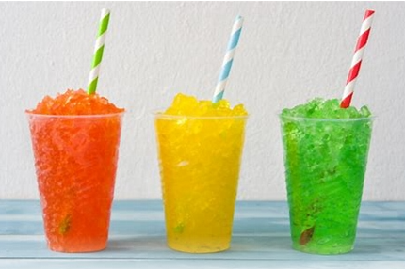
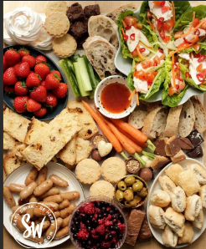
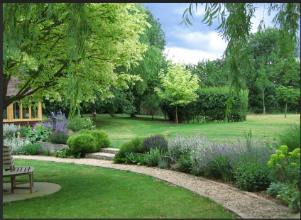


Braitling OSHC School Holiday Program
^{13th} – 20thDecember 2024
BOOKINGS after 28st November will result in $20 late admin fees
For bookings email: Braitling.oshc@ynt.org.au
For enrolments visit: oshc.nt.ymca.org.au/family-before-after-school
Friday 13th December
Monday 16^{th December}
Tuesday 17th
December
Wednesday18th December
Thursday 19th December
Friday 20th December
Hot Chips in the Oval
Today we will be going to the park for a little picnic! We'll have plenty of fun playing on the equipment and enjoying some hot chips together.
Time:09:00 am
Games & Ice-blocks
Participate in a ra
nge of indoor and outdoor Experiences; board games, cricket on the playground and dodge ball at Braitling hall
Wheels Day
The return of a fan fave! Wheels day is back once again. Bring your bikes or scooter and have a wheeeelie good time!
Don’t forget your helmet.
$80 GREEN
Christmas Day Party
Finishing off the last day with a frenzy Friday full of hair styles , face painting, food, games and Movie
Time:-01:00 pm
$ 100 GREEN
Slushie Party
Come and make your own flavored slushie.
Add your Flavors
and Enjoy during the hot Day
Time:-11:00 am
Food Fiesta
Celebrating feast day food, activities, and fun are a great way to teach the kids about ‘No wastage of food’
Time:-10:00 am
$ 95 RED
$ 80 RED
$95 GREEN
$90 GREEN
Y NT Braitling OSHC
Bunny Khosa OSHC Coordinator
e: Braitling.Oshc@ynt.org.au/Phone:-0447172857

Slide 2





Braitling OSHC School Holiday Program
6th – 10th January 2025
BOOKINGS after 28st November will result in $20 late admin fees
For bookings email: Braitling.oshc@ynt.org.au
For enrolments visit: oshc.nt.ymca.org.au/family-before-after-school
Monday 6th January
Tuesday 7th January
Wednesday 8th January
Thursday 9TH January
Friday 10th January
Wednesday 25th
^{September}
OSHC Sports Day
Scrapbooking
Today we will explore our Environment. We will take photos of the world around us, nature ,wildlife and then put them all together in a scrapbook
Time:-10:30
$ 95 AMBER
60 Seconds Challenge
Minute to win it
You have got a minute to win it! You are invited to come and participate in a range of 60 second challenges. There will be lots of prizes to be won.
Time:- 10.30
Party Games
Musical Chairs, Passing the Parcel, Duck Duck Goose, what’s the Mr. wolf, Bingo and many more
Time:-10:30
$ 90 AMBER
The fun side of summer by trying out our unique Sports Day.
We will have a special sports activities with our children
Jewellery Day
Create your own handmade wearable art at Jewellery making
Time:-10:30
$ 95 AMBER
$95 AMBER
Y NT Braitling OSHC
Bunny Khosa OSHC Coordinator
e: Braitling.Oshc@ynt.org.au/Phone:-0447172857

Slide 3





Braitling OSHC School Holiday Program
13th – 17th January 2025
BOOKINGS after 28st November will result in $20 late admin fees
For bookings email: Braitling.oshc@ynt.org.au
For enrolments visit: oshc.nt.ymca.org.au/family-before-after-school
Monday 13th January
Tuesday 14th January
Wednesday 25th
^{September}
Thursday16TH January
Friday 17th January
Wednesday 15th January
Big screen Movie & Treasure Hunt
Movie in the Braitling Hall on the Giant screen.
We will follow clues around the school in our search for treasure
Time:- 11:30
Make it then Break it
Making things is fun but breaking this is fantastic!
How many things can you build today, before you break it down?
Time:-10:30
Sausage sizzle Party
Cook and serve sausages in bread which are grilled or barbecued sausages served in sliced bread
Time:-10:30
$ 85 AMBER
Sundae’s
Decorate and enjoy your own ice cream sundae with syrups and toppings galore
Time:- 10.30
Bunnings Fun Craft
We will be having a fun craft session from Bunnings people
With Great Craft ideas
Time:-10:30
$ 90 GREEN
$105 AMBER
$77 AMBER
Y NT Braitling OSHC
Bunny Khosa OSHC Coordinator
e: Braitling.Oshc@ynt.org.au/Phone:-0447172857

Slide 4


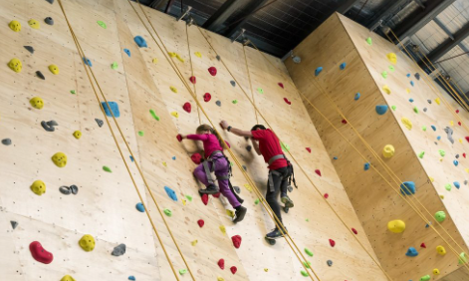


Braitling OSHC School Holiday Program
20th – 24th January 2025
BOOKINGS after 28st November will result in $20 late admin fees
For bookings email: Braitling.oshc@ynt.org.au
For enrolments visit: oshc.nt.ymca.org.au/family-before-after-school
Monday 20th January
Tuesday 21th January
Wednesday 25th
^{September}
Thursday23TH January
Friday 24th January
Wednesday 22th January
Kids Take Over
Today the balls are in your court!
You pick and choose
What we do today for Vacation Care.
We are all ears!
Sport- you decide!!
Craft- you decide
Time:- 11:30
PJ and PIE DAY
Do you love wearing your PJ’S? coz we do!
So, slip out of bed and straight to vacation care in your PJ’S and enjoy a yummy hot pie or Lunch.
Time:-10:30
$ 80 AMBER
Can you Dance?
Bring along your dancing shoes for a day of just Dance.
We will have a special Dance teacher coming in today
Time:-2.00pm
Craft Day
Today you will be provided with everything you need to make craft.
Time:- 10.30
YMCA Rock Climbing
Rock climbing is an exciting and challenging sport to enjoy.
Build strength, fitness, endurance, balance, flexibility, and confidence whilst scaling one of our many fantastic climbs.
Time:-10:00
$100 AMBER
$110 AMBER
$ 95 GREEN
Y NT Braitling OSHC
Bunny Khosa OSHC Coordinator
e: Braitling.Oshc@ynt.org.au/Phone:-0447172857

Slide 5
Braitling OSHC School Holiday Program
27th – 29th January 2025
BOOKINGS after 28st November will result in $20 late admin fees
For bookings email: Braitling.oshc@ynt.org.au
For enrolments visit: oshc.nt.ymca.org.au/family-before-after-school
^{r}
Public Holiday
27th January 2025
Monday
Pupil free day (please book along with the Vacation care program)
28th January 2025 Tuesday
Schools are back to normal
29th January 2025 wednesday
Y NT Braitling OSHC
Bunny Khosa OSHC Coordinator
e: Braitling.Oshc@ynt.org.au/Phone:-0447172857

Slide 6



