Slide 1











OSHC School Holiday Program
24 ^{th} – 28th June
BOOKINGS after 7th June will result in $20 late admin fees
For bookings email: Bradshaw.oshc@ynt.org.au
For enrolments visit: oshc.nt.ymca.org.au/family-before-after-school
Monday 24th June
Tuesday 25th June
Wednesday 26th
^{June}
Thursday 27th June
Friday 28th June
Tie Dye
This is a great and engaging craft activity that children love. Bring your white shirts and let’s Learn different Tie Dyes at Vacation Care with our Lovely friends.
YMCA Recreation centre
Let’s Enjoy the Day at YMCA Rec Centre,
Rock climbing , bubble soccer or any other activity or sports your child/ren wants to Enjoy in the stadium.
Pyjama Party
Clay Day
Clay provides an open canvas for children to express their creativity freely think outside the box, visualize ideas, and transform your imagination to creation
Jewellery Making
String beads onto a thread length to create a simple bracelet or necklace for you and your Loved ones.
Pajama parties are the perfect way to spend time with your friends.
Get ready for a day of comfort and fun with these cozy pajama day with Hot chips and your favorite Movie
$90 GREEN
$90 AMBER
$110 AMBER
$ 90 GREEN
Y NT Bradshaw OSHC
Asma Dhuka OSHC Coordinator e: Bradshaw.oshc@ynt.org.au

Slide 2
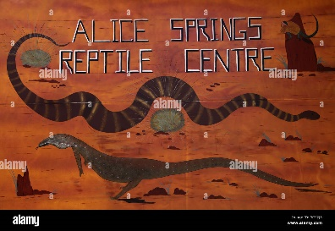


OSHC School Holiday Program
1st – 5th July
BOOKINGS after 7th June will result in $20 late admin fees
For bookings email: Bradshaw.oshc@ynt.org.au
For enrolments visit: oshc.nt.ymca.org.au/family-before-after-school
Monday 1st July
Tuesday 2nd July
Wednesday 3rd July
Thursday 4th July
Friday 5th July
Alice Springs Reptiles
Let’s Explore
A very informative talk about snakes and reptiles, You will see many reptiles including Thorny Devils, Central Bearded Dragons, and lots of snakes
$ 100 RED
ART ATTACK!
Today is going to be lots of fun as we get to channel our inner Picasso while turning everyday items into a beautiful masterpiece of Art initiated by your artistic and creative mind
Make your own Favorite chilled Milkshake
Rich, creamy and indulgent – the milkshake is perhaps one of the world’s most perfect dessert foods.
Children with Allergy will have choices
OSHC Carnival Day
Today is Carnival Day we will be doing
Face painting
Crazy hair
Making Hot dogs for lunch
RECYCLE AND REUSE
Let’s make recycling fun by reusing old materials like fabric, boxes, containers and etc.to create something useful for play, something decorative for your room or as a gift for a friend, teacher or loved
$ 95 RED
$90 GREEN
$85 GREEN
$95 GREEN
Y NT Bradshaw OSHC
Asma Dhuka OSHC Coordinator e: Bradshaw.oshc@ynt.org.au

Slide 3


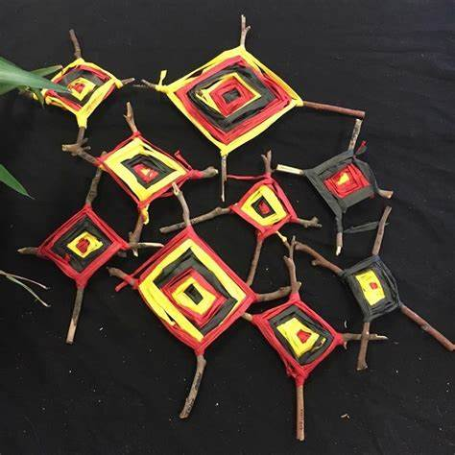


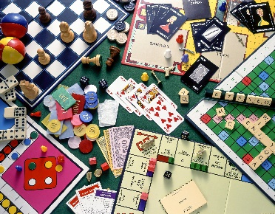
OSHC School Holiday Program
8th – 12th July
BOOKINGS after 7th June will result in $20 late admin fees
For bookings email: Bradshaw.oshc@ynt.org.au
For enrolments visit: oshc.nt.ymca.org.au/family-before-after-school
Monday 8th July
Tuesday 9th July
Wednesday 10^{t}
July
Thursday 11th July
Friday 12th July
CULTURAL DAY
Come join us as we learn about Indigenous culture and engage in experiences to support their learning.
Yarn Knitting
Fun and easy activity make pipe cleaner animals. We can make snakes and Lizards but you could make lots of other animals. Or anything you like for Naidoc week
Designing and decorating picture frames
Bring your family Loved one’s photos and make a photo frame for your bedrooms
ZUMBA Party
Bring your dancing shoes and join us for a ZUMBA dance party
BOARD GAMES
Last Day Relaxing Day
You’ll spend your time in the game thinking deeply about your next moves, and slowly creating your ideal space
$100 AMBER
$80 AMBER
$90 AMBER
$80 AMBER
Y NT BradshawOSHC
Asma Dhuka OSHC Coordinator e: Bradshaw.oshc@ynt.org.au

Slide 4



PARENTINFORMATION&BOOKING
OSHCwill be opened: 7:30am– 6:00pmMonday– Friday. Please be sure to Sign your Children in and Out.
How to book
1. If you are an existing Family at our OSHC service , please book sessions using XPLOR, or by email. This will mean you are already enrolled, and no new enrolment is required.
Fees
From $74.50 a day as base rate
Incursion and excursion fees are dependent on the activities and will be advertised for each vacation care period
Late pick up fees is $15per 15-minute increments
Commonwealth Child Care Subsidy (CCS) is available to eligible families.
YMCA have partnered with Debit Success for all fee payments. Families must complete a direct debit form to attend the service or have their billing details updated in the Xplor app once they have successfully enrolled. Fees will be deducted from the nominated account. All booked days will be charged the advertised fee. All absent days will be charged. For existing or returning families if you have not attended the service for more than 3 months please check your billing details are still correct by loging into your Xplor app and checking under Accounts>Finance.
All School Holiday Care fees must be paid in full before care can be provided.
Food and Drinks
Please provide a healthy packed lunch, snacks and drink bottle every day. Please provide enough food for the entire school day.
Morning and Aternoon tea will be provided.
No spending money is permitted
Excursions
Children must be at the venue by 9am on excursion days.
TrafficLightSystem
Here at YMCA we understand that we cater for and support many families of children with additional needs and or sensory processing needs. We acknowledge that many of these can vary from child to child, some are diagnosed and others are not, this may also include anxiety.
ElectronicDevices
Hand held and all electronic devices
i.e ipads, phones, ipods, PS2 etc. are not permitted at the centre. If a child brings an electronic toy or mobile device, staff will keep this in a safe place until families arrive.
2. For New Families that wish to Enrol:
MedicalConditions
Please provide all necessary medications, asthma inhalers, spacers, Epipens/ Anapens, etc. Speak to educators and complete necessary paperwork on arrival.
Medical action plans and risk minimisation plans must be completed and submitted with enrolment forms.
Individual Anaphylaxis Medical Action Plans will be displayed where all staff can readily access them.
All families to be aware that children at risk of anaphylaxis will be attending the vacation care program. Please be aware of the various allergies that children
suffer from, for example: peanuts, tree nuts, eggs, sesame seeds
A risk minimization plan is required to be developed for all children who have been diagnosed with anaphylaxis, asthma, diabetes
or any other medical condition in consultation with educators on enrolment.
https://oshc.nt.ymca.org.au/enrolment/ Please note that if you have not yet applied for CCS with MyGov, that this can be a 4 week process and it is recommending you apply early.
CCS rules apply. CCS not applicable for absent days at the beginning and end of care.
To help families in deciding what activities are suitable for each individual child and their needs we have created the Traffic Light System.
The Traffic Light System is exactly as it sounds, a variation of coloured
dots indicating what level of sensory difficulties that may be encountered in each programmed activity.
RED:indicating that throughout the activity a large amount of sensory difficulties may be encountered.
Parents may decide at their own discretion upon consultation with the coordinator, if their child will be able to participate comfortably. Children attending on these days will require an Inclusion Support Plan.
AMBER:Indicating that there is a medium level of sensory difficulties that may be encountered, parents may decide at their own discretion upon consultation with the coordinator, if their child will be able to participate comfortably. Children attending on these days will require an Inclusion Support Plan.
GREEN:Indicating that this activity will be a wonderful opportunity for your child to participate comfortably.
Behaviour Management Policy
YMCA has the right to remove or refuse further participation of any child whose behaviour is deemed to be inappropriate. Bullying, bad language and harassment of other children and educators will not be tolerated under any circumstances.
Submit your completed excursion permission forms via one of the following options:
  Email: Bradshaw.oshc@ynt.org.au
Hand into the center.
Children with additional needs
In accordance with the application for enrolment procedure we may be able to provide additional educator support to include children with additional needs and children from culturally and linguistically diverse backgrounds.
Prior to booking, please discuss your specific circumstances with the service coordinator.
Enrolments window ends Friday of week 8. So please be quick to secure your child’s place. Late and extra bookings will only be accepted if there are available spaces.
Excursions are capped due to travel limited availability; please ensure you are quick to avoid disappointment.
Late enrolments will incur a $20 late fee administration charge.
Clothing and Footwear
Please send children in clothes appropriate for the activity they will be participating in.
Children will be required to wear sun-smart hats every day.
Please ensure adequate footwear each day. Nobare feet or thongs.
At the Y, we are committed to empowering all Children and Young People to feel safe and be safe, at the Y, in their families and in their communities.
As such, we ensure that all of our candidates are appropriately screened (including police checks) to make sure that the right people are in the right roles.
To learn more about our screening processes, click here to view our Safeguarding Children and Young People Policy: https://ymca.org.au/about-us/safeguarding-children-young-people/safeguardingresources/

